Slide 1
Estimating Economic Cost of Sea Level Rise on Low-Lying Coastal Properties in Accra, Ghana
Ibrahim Amidu
MESc Candidate, 2016

Slide 2
Roadmap
Background of the study
Justification for the study
Study area
Data Collection/ Analysis
Results/ Discussion
Conclusion/Acknowledgement

Slide 3
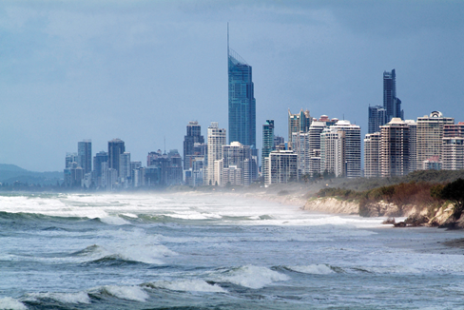
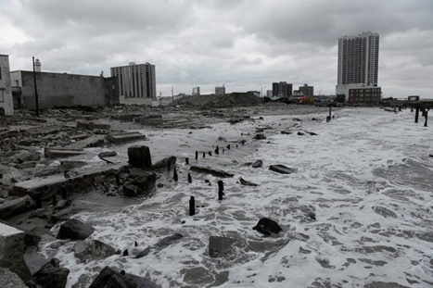
Background
Coastal erosion around the world
© http://www.runawaybaymarina.com.au
© http://theconversation.com

Slide 4
Justification for study
Global issue
Nicholls et al. (2008) …… 136 countries
Coast of Accra, Ghana
Studies by Appeaning Addo

Slide 5
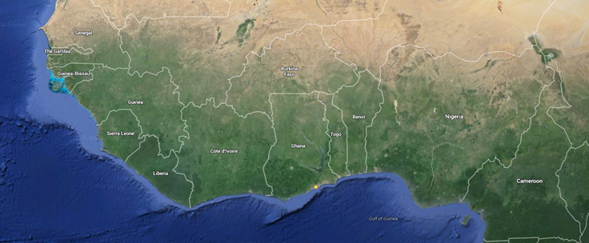
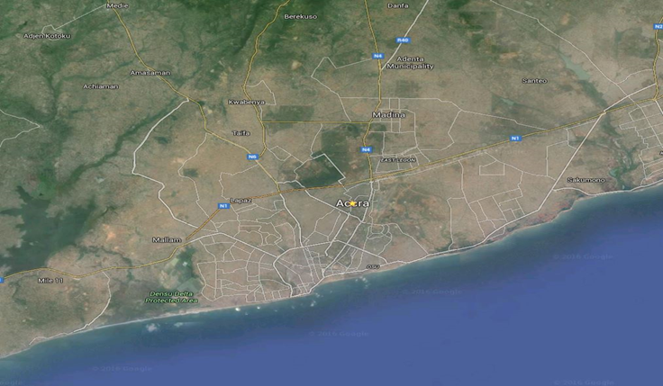
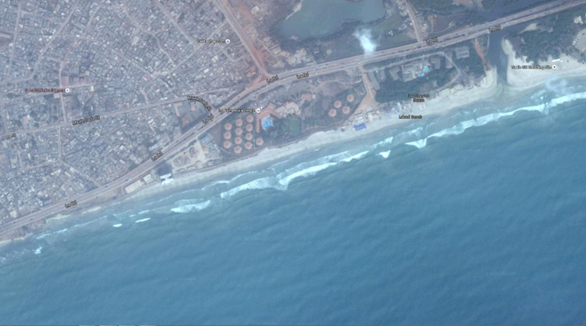
Study Area
© All 3 maps were taken from Google Earth

Slide 6
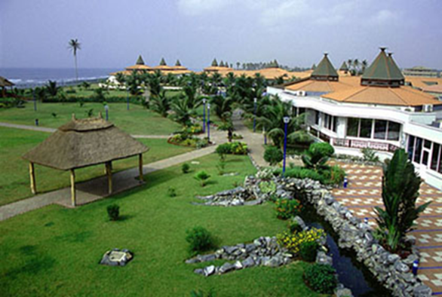
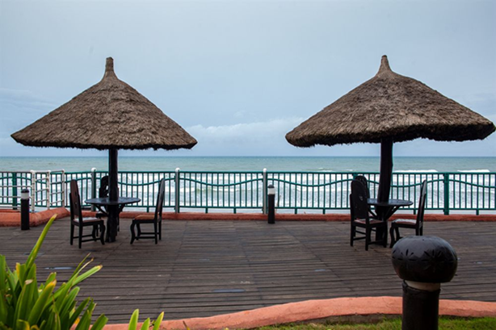
Some Properties in the Study Area

Slide 7
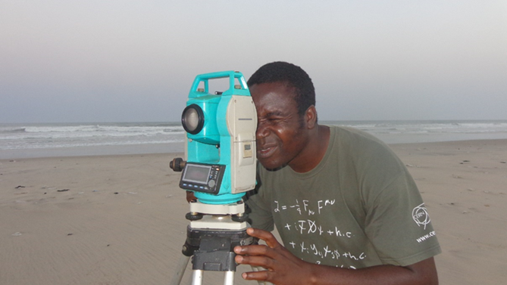
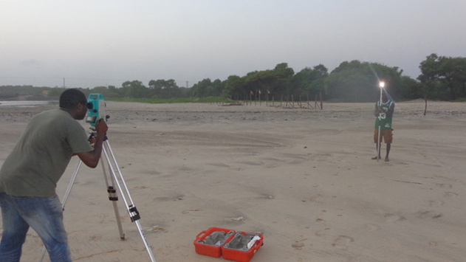
Data Collection

Slide 8
Data Analysis
IPCC scenarios : 0.2m, 0.49m or 0.86m
Decadal rental value of land: $p\left(t\right)=p(0)e^{ρt}$
Market value of possible inundated area: $p\left(T\right)=p\left(t\right)A(t)$
Present value of protecting coastland: $PV[B(t₀,t₀+10)]$=$\int_{0}^{10}{p(t)e^{−rt}dt}$
Construction cost: $CC\left(t\right)=1000∗[H(t₀+10)²−H(t₀)²]∗L$
PV of cost of protecting the land: $PV[C(t₀,T)]=CC\left(t\right)+\int_{0}^{10}{0.04∗CC(t)e^{−rt}dt}$
PROTECTION: PV[B(t₀,t₀+10)] > PV[C(t₀,T)]

Slide 9
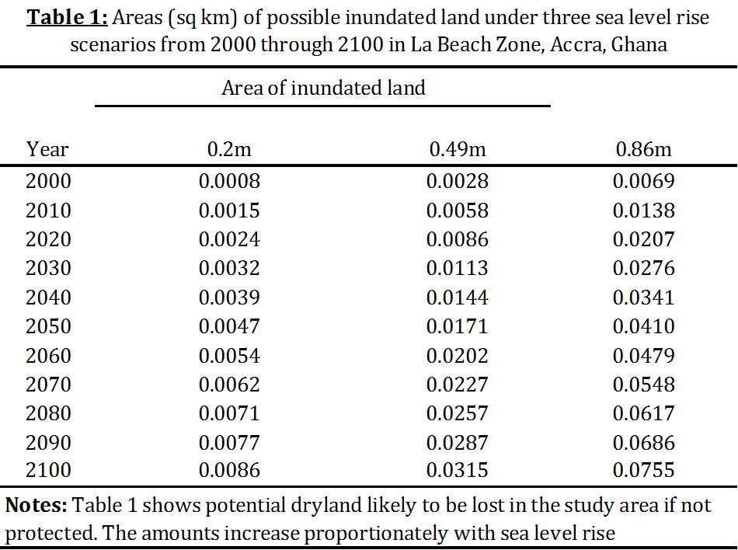
Results/Discussion

Slide 10
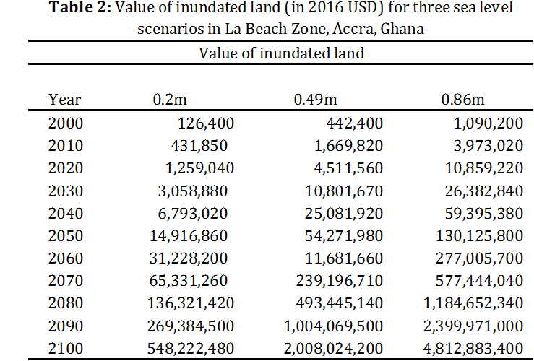
Results/Discussion

Slide 11
Acknowledgement
Robert O. Mendelsohn

Slide 12
Acknowledgement
Hixon Centre

